Slide 1
If you lived in the 20th Century
what do you think life was like?

Slide 2
How big is your neighbourhood?
Taken from the Preston Town Hall looking towards Thornbury this is what High Street in Preston looked like in 1907.

Slide 3
What does your house look like?
In 1900 your house looks like this. It is not very big and there are only four rooms. The toilet is outside and you bath in a tub by the fire. You share a bedroom with your brothers and sisters and feel lucky that you don’t have to share with your parents as well. For rich families a house looks…

Slide 4
…like this

Slide 5
What do you wear?
This is your family in 1910 on the veranda of your new house. You are dressed in your Sunday best for the photo.

Slide 6
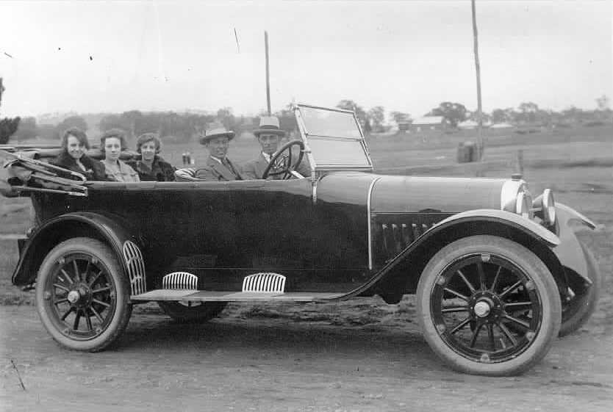
How do you get around?
In 1920 not many families own a car. If you are one of the lucky ones your family car looks like this. Your dad earns about $1000 a year and a cheap car costs $430. An expensive one is $2000. Most people can’t afford a car so they get around…

Slide 7
…like this…
…or like this

Slide 8
Where do you shop?
There was no Northlands Shopping Centre in 1930 so where did you go to shop? The local shop was often a general store combining a bakery, groceries and post office. The chemist could also be a tobacconist and sometimes a hairdresser and even a library like this one.

Slide 9
Where do you hang out?
In 1940 there is no internet, no television, no Xbox, iPads or mobile phones. Are you bored? Never. You go to the cinema once a week. Before the main movie they have a short feature (a cartoon or a cowboy serial). At half-time you spend your pocket money on an ice cream.

Slide 10
Who are your friends?
In 1950 you join the scouts or if you play a musical instrument you would be in a band. These are your friends.

Slide 11
What is happening in the world?
Your dad and your older brothers are going away to fight in a war overseas. The 20th Century wars were World War I, World War II, Korea, Vietnam, Iraq and others around the world. Most of these were fought by ordinary people who did not want to be soldiers.

Slide 12
So was life really that much different?

Slide 13
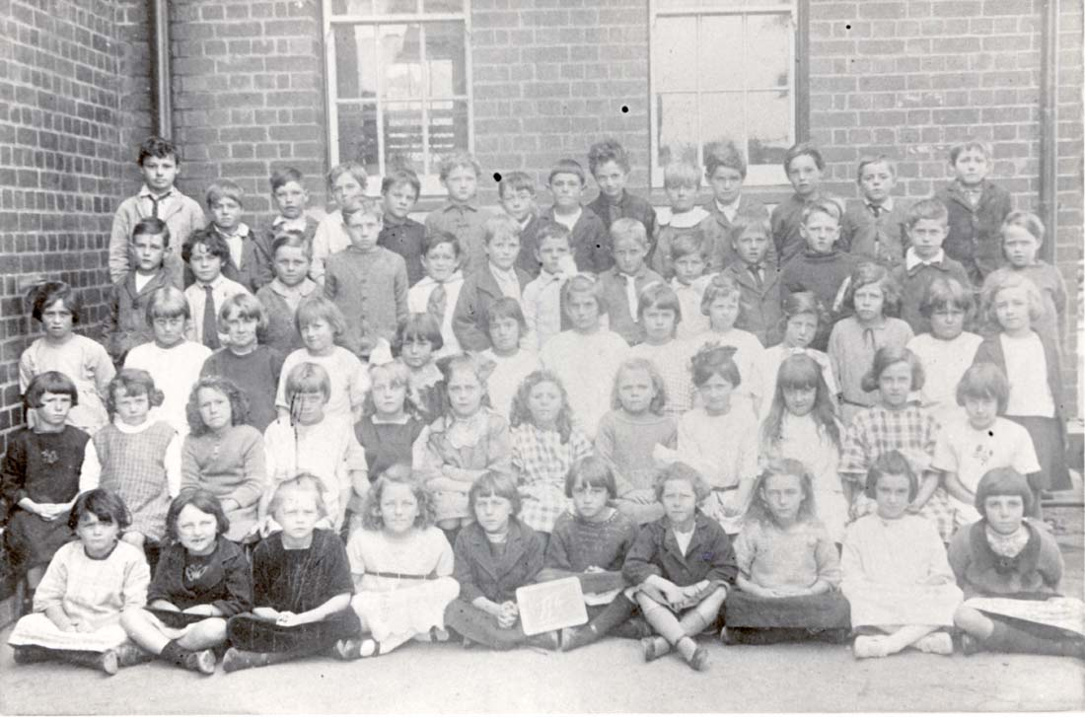
My class photo
My class photo
This is me. Tallest in the class!!
My best friend Ron
If I poke my tongue out do you think they will see?
I’m not pulling a face, this is what I look like
Hurry up and take the photo I need to sneeze
My sister Jane
My girlfriend Susan

