Slide 1
Darebin Fashion Parade
What were the best and worst dressed people of Darebin wearing in the old days?

Slide 2
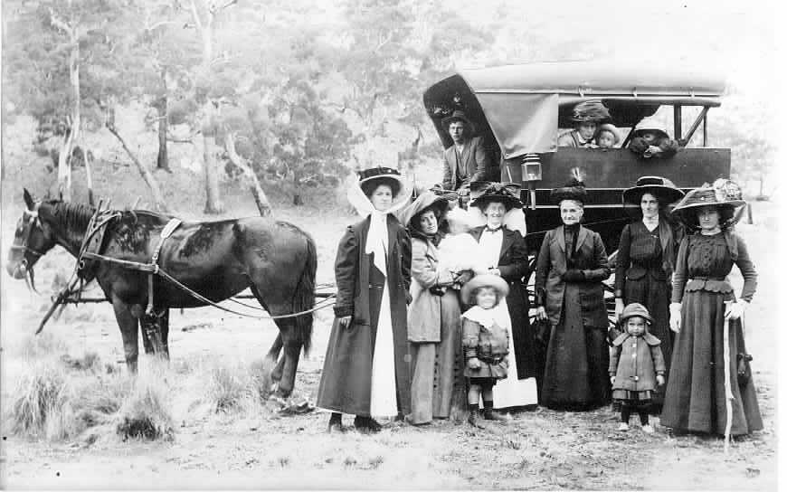
Arriving in style
People used to dress up to go out even for a country picnic like this one. You never went anywhere without a hat. Look at what the children are wearing? Imagine how uncomfortable it was?

Slide 3
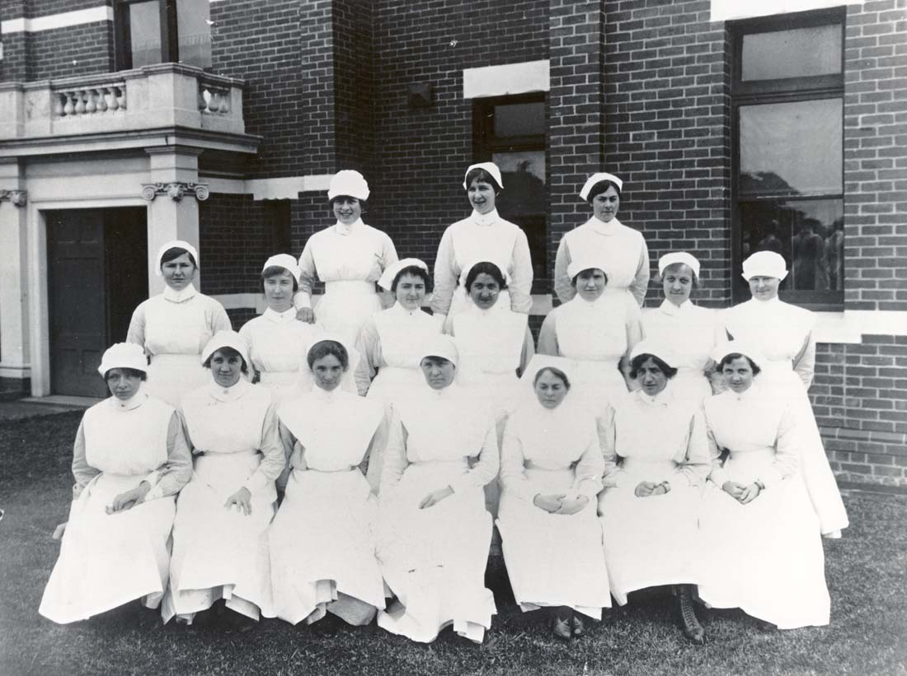
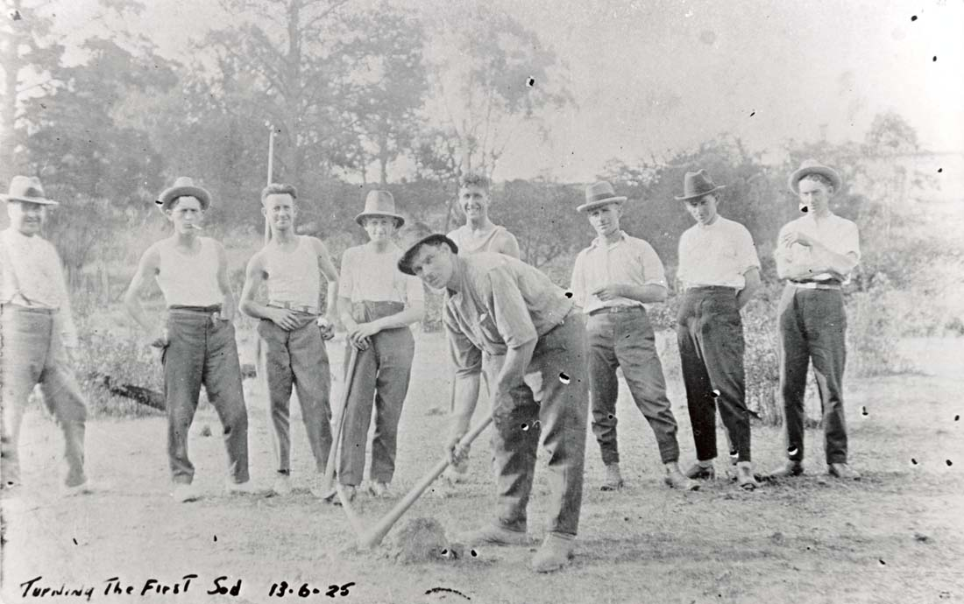
All work and no play
These men are construction labourers. Where are their safety clothes?
And the ladies are nurses from the First World War. Do you think it was easy or hard to work in long skirts?

Slide 4
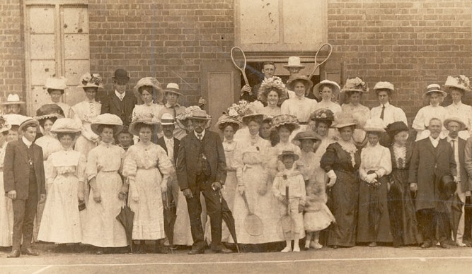
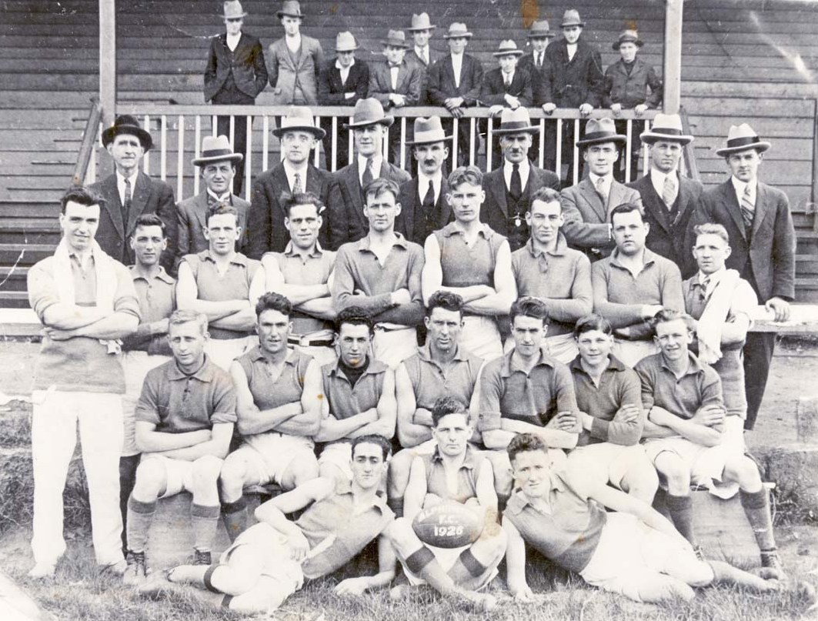
All play and no work
These tennis players had their photo taken after a match in 1900. It would have been hot running around in all those clothes and hard to keep your hat on.
The lads of the Alphington Football Club look like they mean business in this photo taken in 1926.

Slide 5
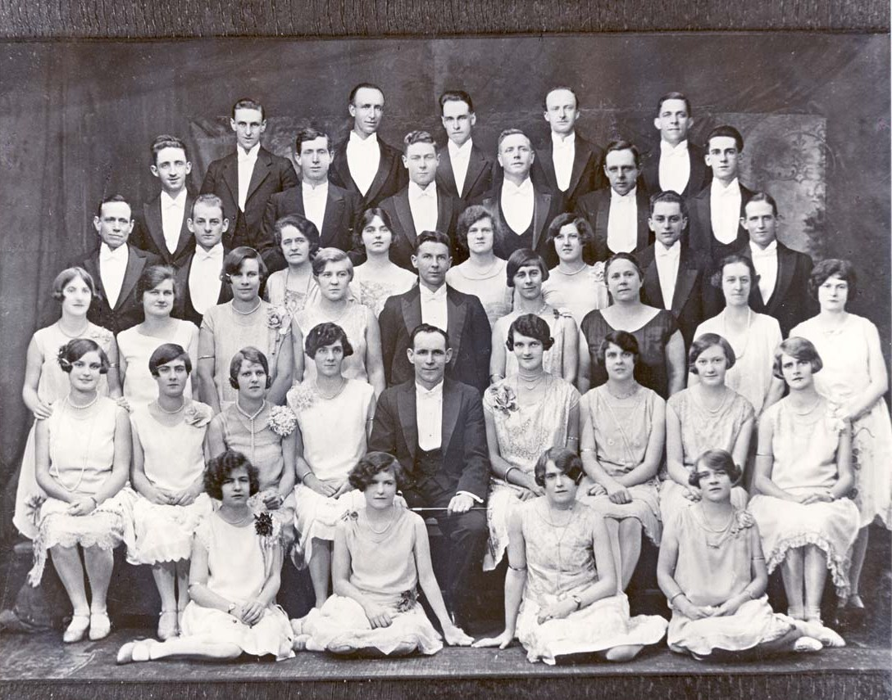
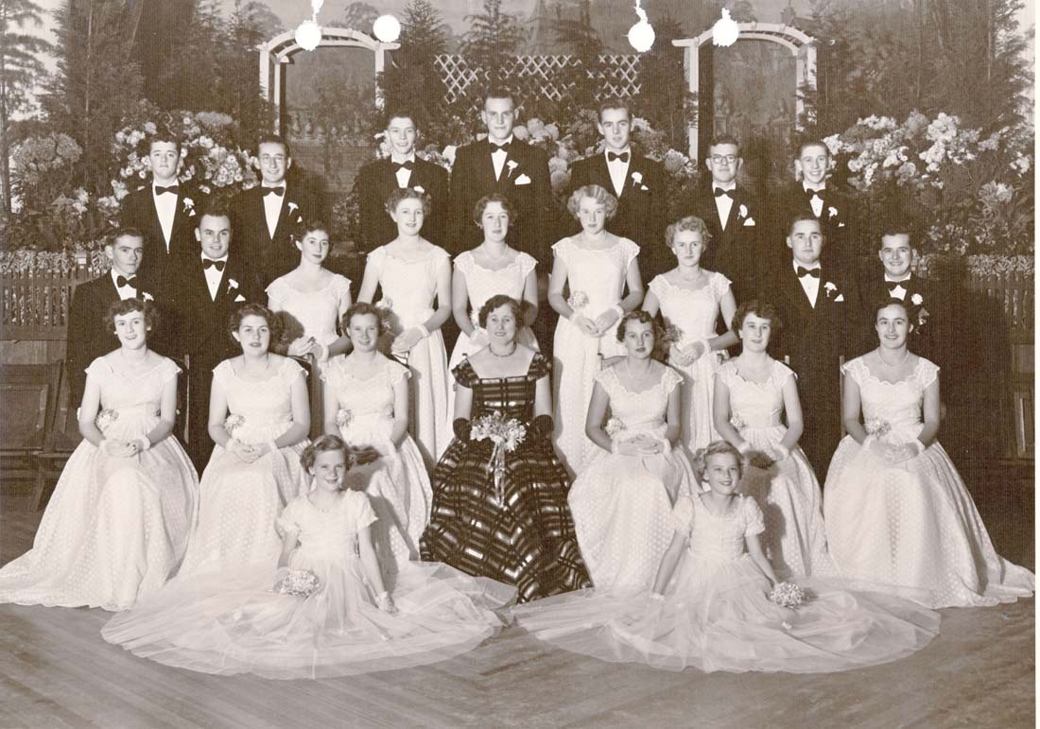
Bowties and party frocks
These beautiful people belong to the Northcote Choral Society photographed in the 1920s. Short hair and knee-length dresses was the latest fashion for ladies.
Young Northcote ladies and their partners attend the Mayoral Ball in the 1950s. At 18 years old this was their first grown up party and they wore a special ‘debutante’ dress. Today people have their own 21st party instead of a group debutante ball.

Slide 6
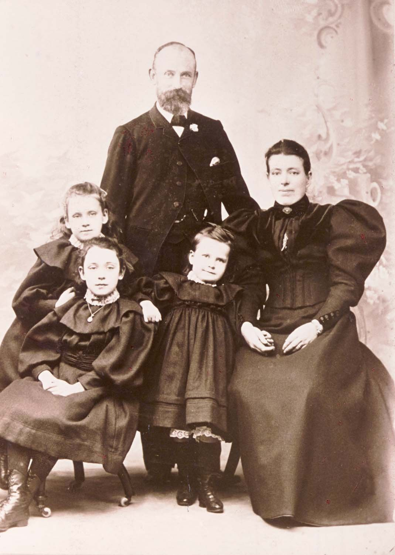
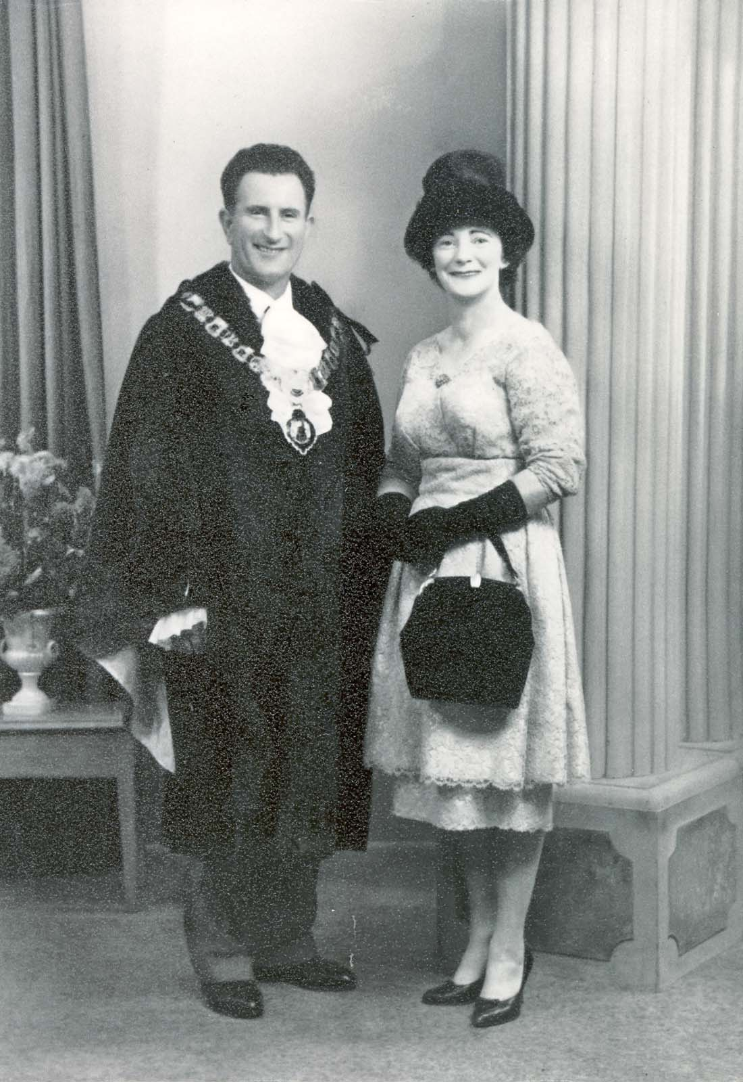
Smile for the birdy
As they sailed for a new life in Australia, families gave a studio portrait to relatives so to remember them. This one is from the 1890s.
This official portrait of Preston Mayor Arthur Houston and his wife was taken in 1960 after his election. They look very proud and smartly dressed. The Mayor is wearing the uniform of his office.

Slide 7
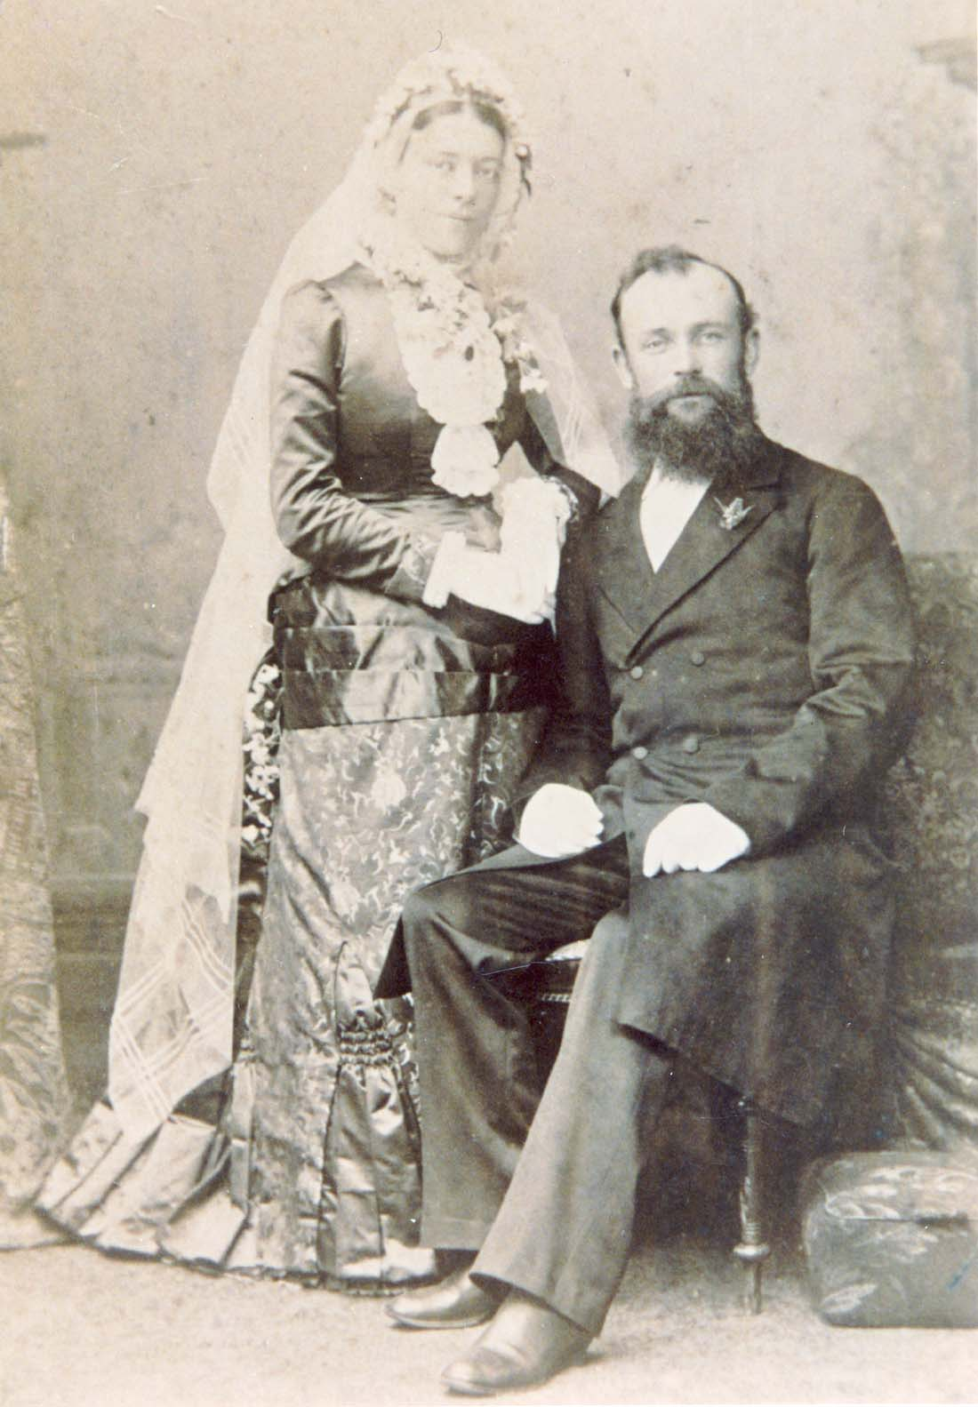
Everyone loves a bride…
Here is a wedding photograph from the 1880s. Brides did not always wear white. In fact they often just got married in their best dress because they could not afford a new dress just for one day. They would wear the same dress to church every Sunday. This one looks like it is made of satin and heavy brocade fabric.

Slide 8
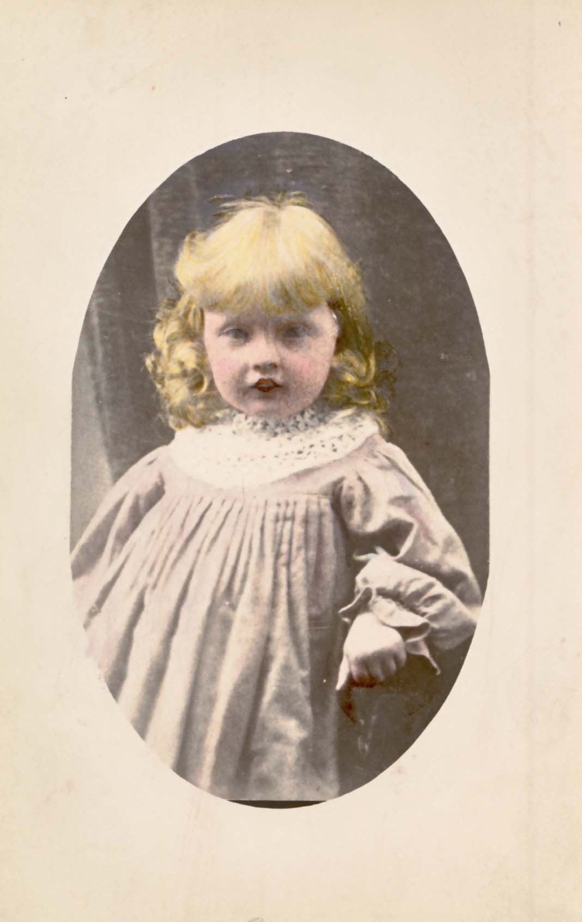
…and a baby
Look at this cute little goldilocks. Is it a boy or a girl? In the old days boys were often dressed in frocks and wore their hair long so it can be hard to tell the difference. This photograph has also been specially coloured by hand.

Slide 9
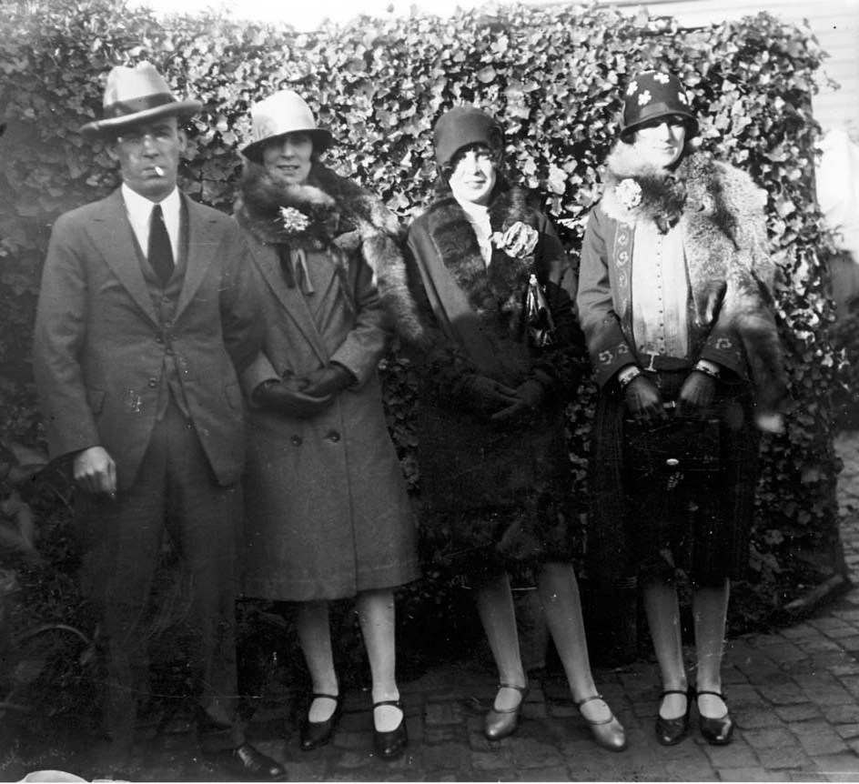
Flappers and Spats
These young people have their dancing shoes on for a night out on the town in the 1920s. The girls are wearing gloves and valuable fox furs around their shoulders. As ladies skirts got shorter in the 1920s shoes and stockings were on show and became fashion items.

Slide 10
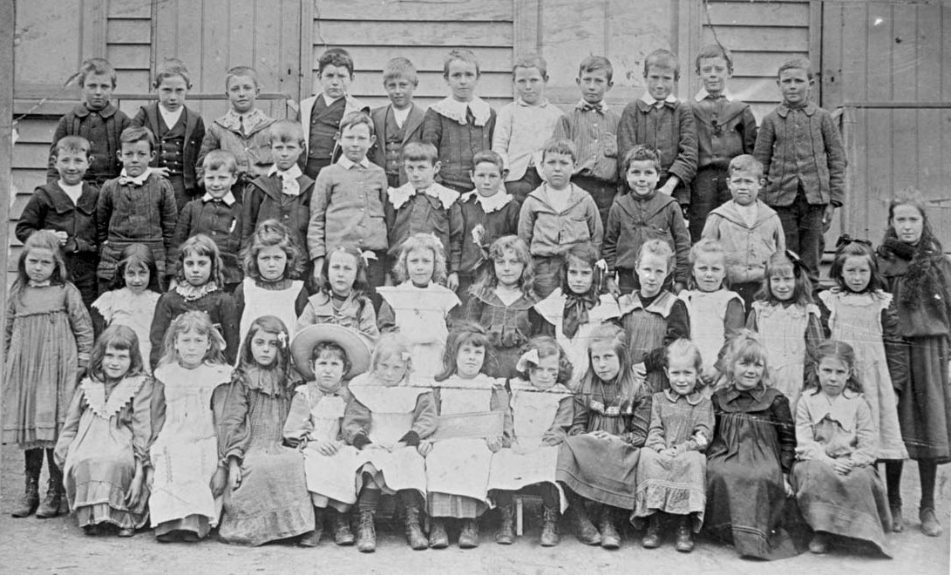
Off to school
This is what you would have worn to school in 1900. Girls wore apron pinafores and ribbons in their hair but it was worse for the boys who look stiff in their collars and woollen jackets, stockings and boots.

